Slide 1
ThedyxEngine
2D Thermodynamics Simulator
Rostyslav Liapkin

Slide 2
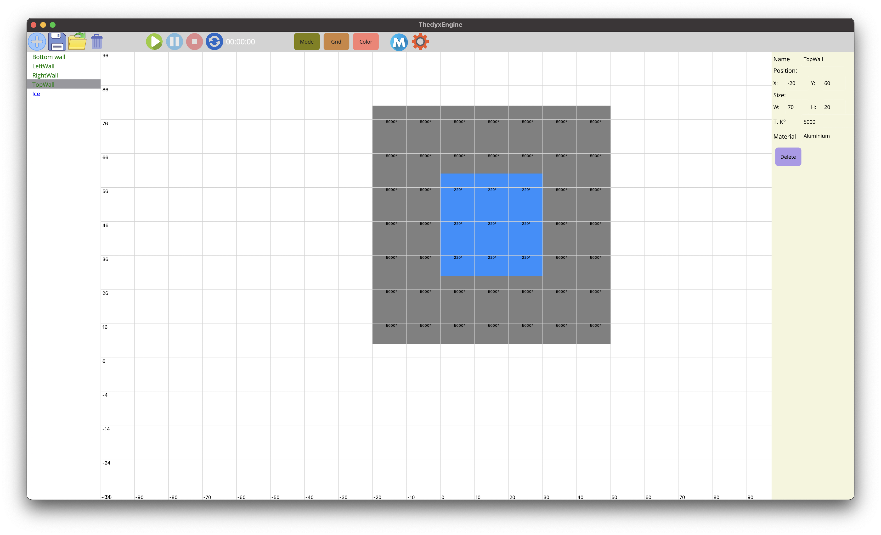
Introduction
ThedyxEngine is a 2D physics engine designed to simulate heat transfer across different materials using a visually intuitive approach.

Slide 3
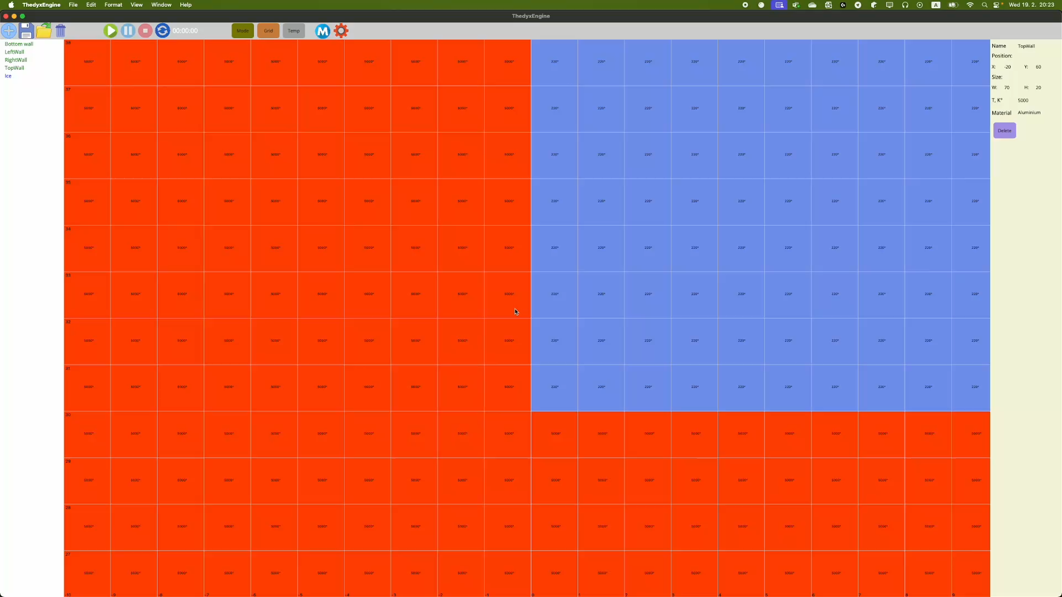
Novelty
Low System Requirements(M4 Max): Optimized to run on modest hardware on different platforms.
Community-Maintained & Open Source: Built with a popular framework and language, available to everyone.
High Precision(in my dreams): Granular simulation for accurate heat transfer modeling.

Slide 4
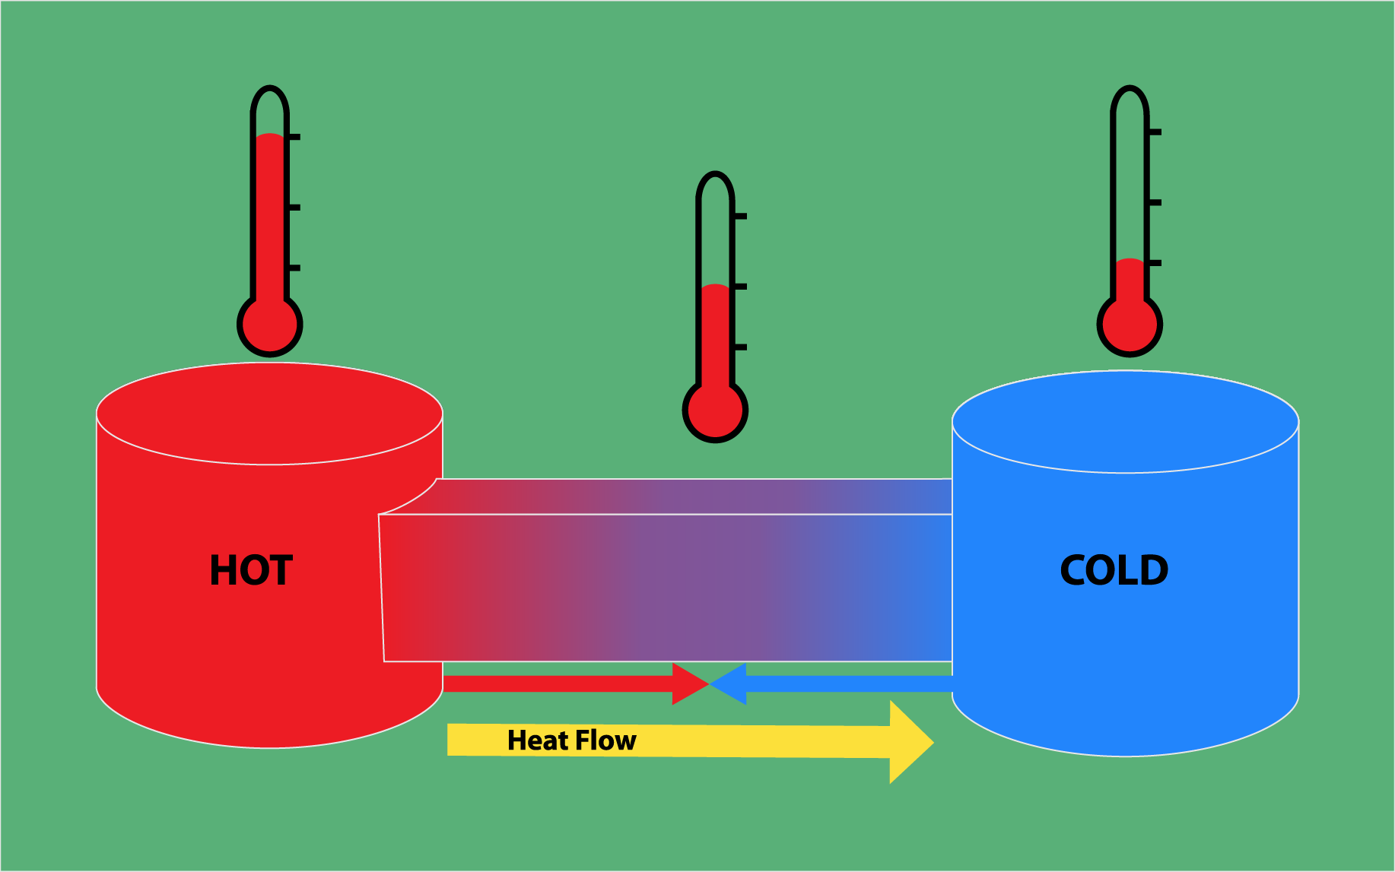
Motivation
Bridging Theory and Practice: Traditional thermodynamics and heat transfer studies are often abstract and theoretical.
User-Friendly Simulation: Existing simulation tools can be too complex for the average user to operate effectively.

Slide 5
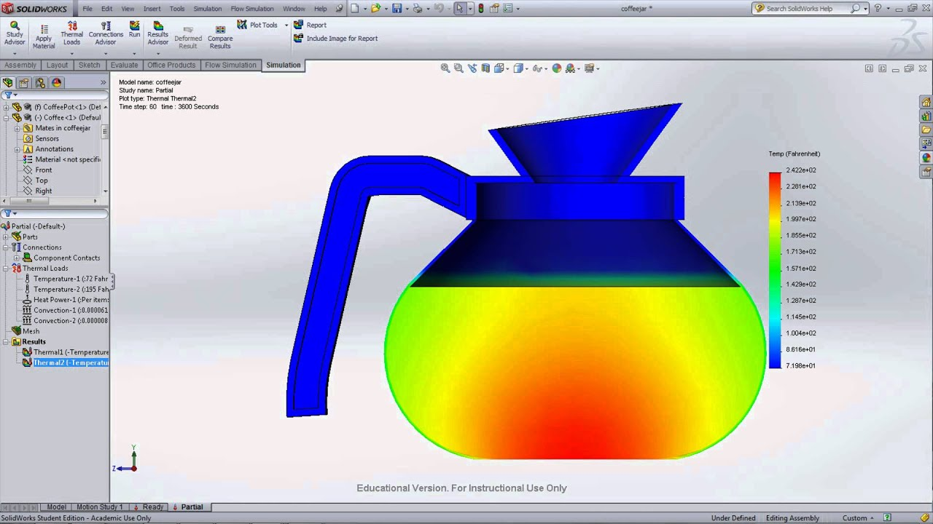
Motivation
Accessible Education: ThedyxEngine serves as a free, intuitive platform that makes thermodynamics accessible for learning and experimentation.
Open-Source Innovation: As an open-source project, it invites collaboration and continuous improvement from the community.

Slide 6
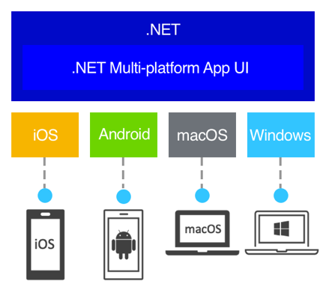
Technologies
Net 9.0 (compatible with .Net 8.0)
MAUI (Multi-platform App UI)
MAUI Community Toolkit

Slide 7
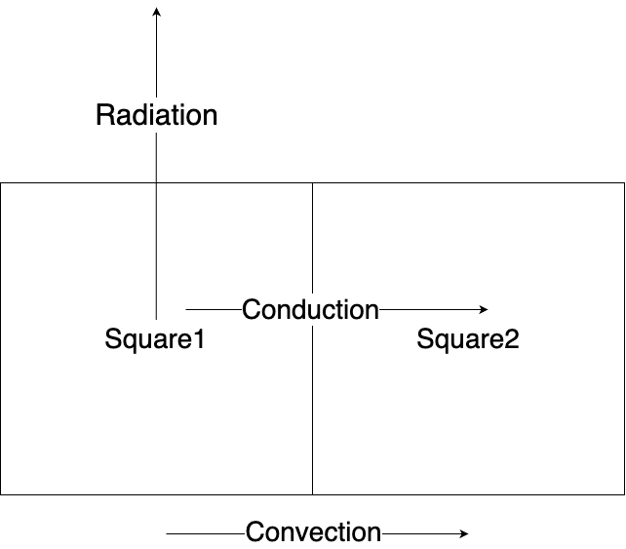
Methodology
Grid-Based Decomposition: Each object is divided into a grid of small squares.
Discrete Energy Transfer: Energy is transferred between grain squares, allowing for localized temperature calculation.
Time-Stepped Simulation: Simulation is made in discrete time steps, calculating the amount of energy transferred in each interval.

Slide 8
Implementations

Slide 9
Precision testing

Slide 10
Limitations
MAUI has its own limitations, but it’s good enough

Slide 11
Future directions
- Rewrite to Rust

Slide 12
Challenges

Slide 13
Benchmarking: Multicore efficiency
TimeSteps in one minute, scene 400 objects 10*10, max zoom, without rendering, only engine
Macbok Pro M3 Pro 16 inches 1 tb ssd(6 performance, 6 efficiency cores). Tested 5 times
cores | 400 objects | 225 objects | 100 objects
1 | 533 |  | 2133
2 | 1036 |  | 4027
3 | 1527 |  | 6058
4 | 1837 |  | 6294
5 | 2022 |  | 6415
6 | 2115 |  | 6743
7 | 2055 |  | 6639
8 | 2091 |  | 6524
9 | 2074 |  | 6337
10 | 2038 |  | 6034
11 | 2042 |  | 5772
12 | 1973 |  | 5569

